Slide 1
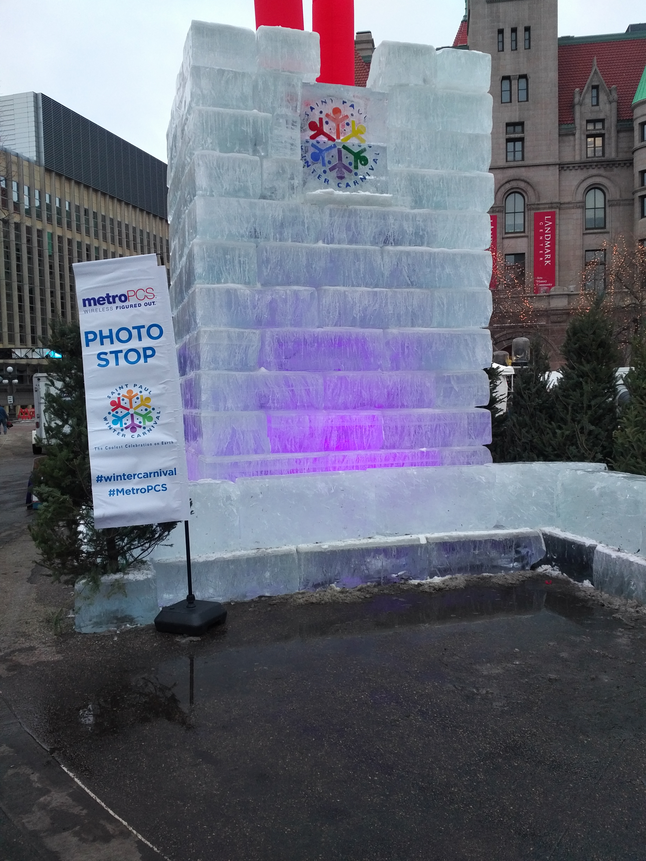
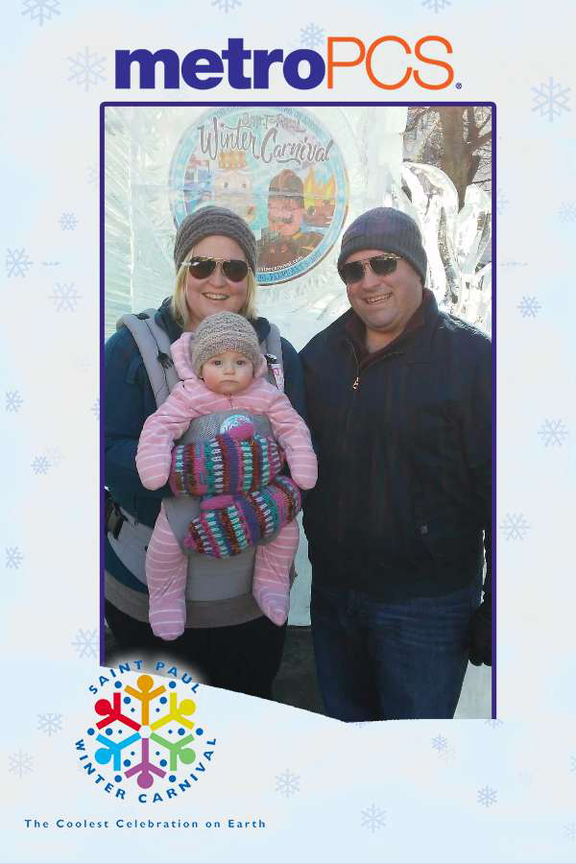
Identifying, Securing & Retaining Quality Sponsors
Building Event Sponsorships Partnerships

Slide 2
Identifying Sponsors Partners
What potential partners “fit” the event itself? Look beyond the obvious.
Considerations
Past Partners
Target Market
Programming (themes, activities, etc..)
On-site activation opportunities
Cross-promotional opportunities
Local connection or presence
Involvement with the community
New product/service launch

Slide 3
Securing Sponsors Partners
Building Custom Partnership Packages
Gone are the days of sponsorship levels (platinum, gold & silver) and charts.
Identify a brands goals & objectives.
Returning partners, identify what worked in previous year.
These are the foundation for building your partnership
As an event what do you need from the partner?
dollars, engagement, additional awareness through social integration and cross promotional opportunities

Slide 4
Securing Sponsors Partners
Increase brand awareness for the partner & event
Social media integration
On-site activation
Cross-promotional opportunities
Utilize email database
Maximize partnership opportunities
Exclusivity
MetroPCS/Winter Carnival Photo Stop
Summit Brewing Company Freeze Your Bags Off Tournament
Cannon River Winery Hot Mulled Wine
Pabst Winter Carnival Music Series
Treasure Island Entertainment Stage
MN Lynx Kid’s Day (The Lynx will play their 17 season at Xcel.)

Slide 5
Custom Partnership Package - MetroPCS
Saint Paul Winter Carnival to Provide
Presenting rights in all advertising (minimum of 2 in Saint Paul Pioneer Press), publicity and social media posts (minimum of 2) for the Saint Paul Winter Carnival Family Day (Rice Park/Landmark Center, Saturday, February 4) – Family Day Presented by MetroPCS
Signage at Family Day event
On-site activation
First right of refusal for 2018 Saint Paul Winter Carnival Family Day
Category Exclusivity (Saint Paul Winter Carnival) – Cellular Retailer & Carrier
Premium 10x20 activation space in Rice Park during 10 days of Winter Carnival
Activation times must match Rice Park programming
Activation space in the Landmark Center for Kids Day, Saturday January 28
Photo Opp locations (4) and co-branded signage
Social Media - minimum of four brand specific social media posts (including, but limited to activities and/or promotions taking place within Rice Park activation)
Logo in print advertising minimum 1 occurrence in Saint Paul Pioneer Press
Logo placement website home page and partners page
Logo and link in the festival newsletter that is emailed to all Saint Paul Festival and Heritage Foundation members, volunteers, corporate sponsors and local media - option for MetroPCS to provide content and/or promotional offer
Large logo placement on the sponsor Ice Wall in Rice Park
Custom logo Ice Sculpture
VIP Tickets (4) for the Vulcan Victory Torchlight Parade and Fireworks show on February 4 (MetroPCS may use for promotional use)
Use of Saint Paul Winter Carnival logo on approved cross-promotional programs
MetroPCS to Provide
Cross promotion of Winter Carnival including, but not limited to promotional signage to be displayed at MetroPCS locations
Photo Opp technology and staff for photo opp locations within Rice Park
Charging station(s) at activation site as well as one additional location TBD

Slide 6
Retaining Sponsors Partners
Post Event Engagement
Event recap to include web-site and social analytics, photos, attendance, media & pr coverage, etc…
Virtual Gift Bag E-blast – This post event, tool allows partners an additional opportunity (added value) to engage with event guests.
Example – For the Saint Paul Winter Carnival 40% of the partners provided content or an offer. Many selected a unique url to track engagement.
Subscribers | Opens | Clicks
13,545 | 2,752 (20.3%) | 214 (1.6%)

